Slide 1
Threads
Pradeep Rao T

Slide 2
Multitasking allows several activities to occur concurrently on the computer. A distinction is usually made between:
Process-based multitasking
Thread-based multitasking
The sequence of code executed for each task defines a separate path of execution, and is called a thread (of execution).
In a single-threaded environment only one task at a time can be performed. CPU cycles are wasted, for example, when waiting for user input. Multitasking allows idle CPU time to be put to good use.
Some advantages of thread-based multitasking as compared to process-based multitasking are
threads share the same address space
context switching between threads is usually less expensive than between processes
cost of communication between threads is relatively low
Java supports thread-based multitasking and provides high-level facilities for multithreaded programming. Thread safety is the term used to describe the design of classes that ensure that the state of their objects is always consistent, even when the objects are used concurrently by multiple threads.

Slide 3
Overview of Threads
Creating threads and providing the code that gets executed by a thread.
Accessing common data and code through synchronization.
Transitioning between thread states
The Main Thread
When a standalone application is run, a user thread is automatically created to execute the main() method. This thread is called the main thread.
The runtime environment distinguishes between user threads and daemon threads. As long as a user thread is alive, the JVM does not terminate.
A daemon thread is at the mercy of the runtime system: it is stopped if there are no more user threads running, thus terminating the program. Daemon threads exist only to serve user threads.
Calling the setDaemon(boolean) method in the Thread class marks the status of the thread as either daemon or user, but this must be done before the thread is started.
Any attempt to change the status after the thread has been started, throws an IllegalThreadStateException.
Marking all spawned threads as daemon threads ensures that the application terminates when the main thread dies.

Slide 4
A thread in Java is represented by an object of the Thread class. Implementing threads is achieved in one of two ways:
implementing the java.lang.Runnable interface
extending the java.lang.Thread class
Runnable interface :
A class implements the Runnable interface, providing the run() method that will be executed by the thread. An object of this class is a Runnable object.
An object of Thread class is created by passing a Runnable object as argument to the Thread constructor. The Thread object now has a Runnable object that implements the run() method.
The start() method is invoked on the Thread object created in the previous step. The start() method returns immediately after a thread has been spawned.
The run() method of the Runnable object is eventually executed by the thread represented by the Thread object on which the start() method was invoked.
important constructors and methods from the java.lang.Thread class:
Thread(Runnable threadTarget)
Thread(Runnable threadTarget, String threadName)
The argument threadTarget is the object whose run() method will be executed when the thread is started.
The argument threadName can be specified to give an explicit name for the thread, rather than an automatically generated one

Slide 5
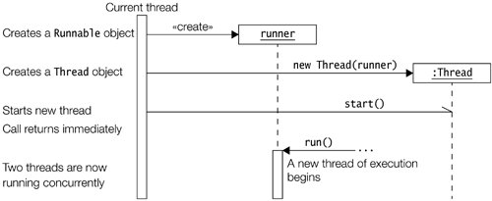
void run() The Thread class implements the Runnable interface by providing an implementation of the run() method.
This implementation does nothing. Subclasses of the Thread class should override this method.
If the current thread is created using a separate Runnable object, then the Runnable object's run() method is called.
final void setDaemon(boolean flag) final boolean isDaemon()
The first method sets the status of the thread either as a daemon thread or as a user thread, depending on whether the argument is true or false, respectively. The status should be set before the thread is started. The second method returns true if the thread is a daemon thread, otherwise, false. RunnableExample.java

Slide 6
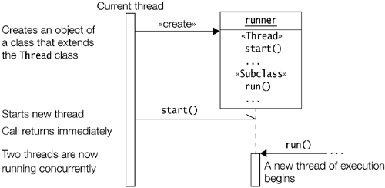
Extending the Thread Class
A class extending the Thread class overrides the run() method from the Thread class to define the code executed by the thread.
This subclass may call a Thread constructor explicitly in its constructors to initialize the thread, using the super() call.
The start() method inherited from the Thread class is invoked on the object of the class to make the thread eligible for running. ThreadExample.java

Slide 7
there are two reasons why implementing the Runnable interface may be preferable to extending the Thread class:
Extending the Thread class means that the subclass cannot extend any other class, whereas a class implementing the Runnable interface has this option.
A class might only be interested in being runnable, and therefore, inheriting the full overhead of the Thread class would be excessive.
Inner classes are useful for implementing threads that do simple tasks. The anonymous class below will create a thread and start it:
( new Thread() { public void run() { for(;;)
System.out.println("Stop the world!"); } } ).start();
Synchronization
Java provides high-level concepts for synchronization in order to control access to shared resources.
Locks
A lock (a.k.a. monitor) is used to synchronize access to a shared resource. A lock can be associated with a shared resource.
Threads gain access to a shared resource by first acquiring the lock associated with the resource. At any given time, at the most one thread can hold the lock (i.e., own the monitor) and thereby have access to the shared resource. A lock thus implements mutual exclusion (a.k.a. mutex).

Slide 8
The object lock mechanism enforces the following rules of synchronization:
A thread must acquire the object lock associated with a shared resource, before it can enter the shared resource. The runtime system ensures that no other thread can enter a shared resource if another thread already holds the object lock associated with the shared resource. If a thread cannot immediately acquire the object lock, it is blocked, that is, it must wait for the lock to become available.
When a thread exits a shared resource, the runtime system ensures that the object lock is also relinquished. If another thread is waiting for this object lock, it can proceed to acquire the lock in order to gain access to the shared resource.
There are two ways in which execution of code can be synchronized:
1. synchronized methods 2. synchronized blocks
Synchronized Methods
If the methods of an object should only be executed by one thread at a time, then the declaration of all such methods should be specified with the keyword synchronized.
A thread wishing to execute a synchronized method must first obtain the object's lock (i.e., hold the lock) before it can enter the object to execute the method.
This is simply achieved by calling the method. If the lock is already held by another thread, the calling thread waits. No particular action on the part of the program is necessary.
A thread relinquishes the lock simply by returning from the synchronized method, allowing the next thread waiting for this lock to proceed.
Synchronized methods are useful in situations where methods can manipulate the state of an object in ways that can corrupt the state if executed concurrently.

Slide 9
Synchronized block in java
Synchronized block can be used to perform synchronization on any specific resource of the method.
Suppose you have 50 lines of code in your method, but you want to synchronize only 5 lines, you can use synchronized block.
If you put all the codes of the method in the synchronized block, it will work same as the synchronized method.
Points to remember for Synchronized block
Synchronized block is used to lock an object for any shared resource.
Scope of synchronized block is smaller than the method.
Syntax to use synchronized block
synchronized (object reference expression) {
//code block
}
Static synchronization
Problem without static synchronization
Suppose there are two objects of a shared class(e.g. Table) named object1 and object2.In case of synchronized method and synchronized block there cannot be interference between t1 and t2 or t3 and t4 because t1 and t2 both refers to a common object that have a single lock.But there can be interference between t1 and t3 or t2 and t4 because t1 acquires another lock and t3 acquires another lock.I want no interference between t1 and t3 or t2 and t4.Static synchronization solves this problem. SynMethodExmaple2.java

Slide 10
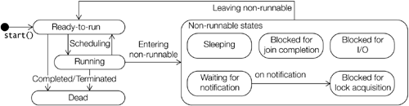
Understanding the life cycle of a thread is valuable when programming with threads.
Threads can exist in different states.
Just because a thread's start() method has been called, it does not mean that the thread has access to the CPU and can start executing straight away. Several factors determine how it will proceed.
Ready-to-run state: A thread starts life in the Ready-to-run state.
Running state: If a thread is in the Running state, it means that the thread is currently executing

Slide 11
Dead state: Once in this state, the thread cannot ever run again.
Non-runnable states: A running thread can transit to one of the non-runnable states, depending on the circumstances.
A thread remains in a non-runnable state until a special transition occurs.
A thread does not go directly to the Running state from a non-runnable state, but transits first to the Ready-to-run state.
The non-runnable states can be characterized as follows:
Blocked for I/O: The thread waits for a blocking operation to complete
Blocked for join completion: The thread awaits completion of another
Waiting for notification: The thread awaits notification from another
Blocked for lock acquisition: The thread waits to acquire the lock of an object
Sleeping: The thread sleeps for a specified amount of time
Thread Priorities
Threads are assigned priorities that the thread scheduler can use to determine how the threads will be scheduled.
The thread scheduler can use thread priorities to determine which thread gets to run. The thread scheduler favors giving CPU time to the thread with the highest priority in the Ready-to-run state.
This is not necessarily the thread that has been the longest time in the Ready-to-run state. Heavy reliance on thread priorities for the behavior of a program can make the program unportable across platforms, as thread scheduling is host platform?dependent.

Slide 12
Priorities are integer values from 1 (lowest priority given by the constant Thread. MIN_PRIORITY) to 10 (highest priority given by the constant Thread.MAX_PRIORITY).
The default priority is 5 (Thread.NORM_PRIORITY).
A thread inherits the priority of its parent thread. Priority of a thread can be set using the setPriority() method and read using the getPriority() method, both of which are defined in the Thread class.
The following code sets the priority of the thread myThread to the minimum of two values: maximum priority and current priority incremented to the next level:
myThread.setPriority(Math.min(Thread.MAX_PRIORITY, myThread.getPriority()+1));
Thread Scheduler
Schedulers in JVM implementations usually employ one of the two following strategies:
Preemptive scheduling: If a thread with a higher priority than the current running thread moves to the Ready-to-run state, then the current running thread can be preempted (moved to the Ready-to-run state) to let the higher priority thread execute.
Time-Sliced or Round-Robin scheduling: A running thread is allowed to execute for a fixed length of time, after which it moves to the Ready-to-run state to await its turn to run again.
It should be pointed out that thread schedulers are implementation- and platform-dependent; therefore, how threads will be scheduled is unpredictable, at least from platform to platform.

Slide 13
final boolean isAlive() This method can be used to find out if a thread is alive or dead. A thread is alive if it has been started but not yet terminated, that is, it is not in the Dead state.
final int getPriority() final void setPriority(int newPriority) The first method returns the priority of the current thread. The second method changes its priority. The priority set will be the minimum of the two values: the specified newPriority and the maximum priority permitted for this thread.
static void yield() This method causes the current thread to temporarily pause its execution and, thereby, allow other threads to execute.
static void sleep (long millisec) throws InterruptedException The current thread sleeps for the specified time before it takes its turn at running again.
final void join() throws InterruptedException final void join(long millisec) throws InterruptedException A call to any of these two methods invoked on a thread will wait and not return until either the thread has completed or it is timed out after the specified time, respectively.
void interrupt() The method interrupts the thread on which it is invoked. In the Waiting-for-notification, Sleeping, or Blocked-for-join-completion states, the thread will receive an InterruptedException

Slide 14
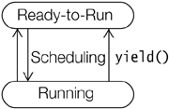
Running and Yielding
A call to the static method yield(), defined in the Thread class, will cause the current thread in the Running state to transit to the Ready-to-run state, thus relinquishing the CPU.
The thread is then at the mercy of the thread scheduler as to when it will run again. If there are no threads waiting in the Ready-to-run state, this thread continues execution.
If there are other threads in the Ready-to-run state, their priorities determine which thread gets to execute.
Sleeping and Waking up: A call to the static method sleep() in the Thread class will cause the currently running thread to pause its execution and transit to the Sleeping state. The method does not relinquish any lock that the thread might have.
The thread will sleep for at least the time specified in its argument, before transitioning to the Ready-to-run state where it takes its turn to run again. If a thread is interrupted while sleeping, it will throw an InterruptedException when it awakes and gets to execute.

Slide 15
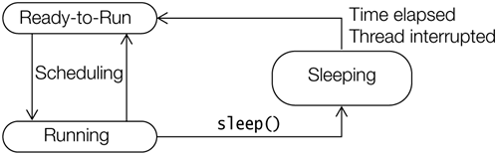
Waiting and Notifying
Waiting and notifying provide means of communication between threads that synchronize on the same object .
The threads execute wait() and notify() (or notifyAll()) methods on the shared object for this purpose.
These final methods are defined in the Object class, and therefore, inherited by all objects.
These methods can only be executed on an object whose lock the thread holds, otherwise, the call will result in an IllegalMonitorStateException.
final void wait(long timeout) throws InterruptedException
final void wait(long timeout, int nanos) throws InterruptedException
final void wait() throws InterruptedException
A thread invokes the wait() method on the object whose lock it holds. The thread is added to the wait set of the object.

Slide 16
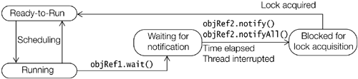
final void notify()
final void notifyAll()
A thread invokes a notification method on the object whose lock it holds to notify thread(s) that are in the wait set of the object.
Communication between threads is facilitated by waiting and notifying, as illustrated by Figures .
A thread usually calls the wait() method on the object whose lock it holds because a condition for its continued execution was not met.
The thread leaves the Running state and transits to the Waiting-for-notification state. There it waits for this condition to occur. The thread relinquishes ownership of the object lock.

Slide 17
A thread in the Waiting-for-notification state can be awakened by the occurrence of any one of these three incidents:
Another thread invokes the notify() method on the object of the waiting thread, and the waiting thread is selected as the thread to be awakened.
The waiting thread times out.
Another thread interrupts the waiting thread.
Notify:-Invoking the notify() method on an object wakes up a single thread that is waiting on the lock of this object.
The selection of a thread to awaken is dependent on the thread policies implemented by the JVM.
On being notified, a waiting thread first transits to the Blocked-for-lock-acquisition state to acquire the lock on the object, and not directly to the Ready-to-run state
A call to the notify() method has no consequences if there are no threads in the wait set of the object.
In contrast to the notify() method, the notifyAll() method wakes up all threads in the wait set of the shared object. They will all transit to the Blocked-for-lock-acquisition state and contend for the object lock as explained earlier.
Time-out: The wait() call specified the time the thread should wait before being timed out, if it was not awakened.
The awakened thread competes in the usual manner to execute again. Note that the awakened thread has no way of knowing whether it was timed out or awakened by one of the notification methods.

Slide 18
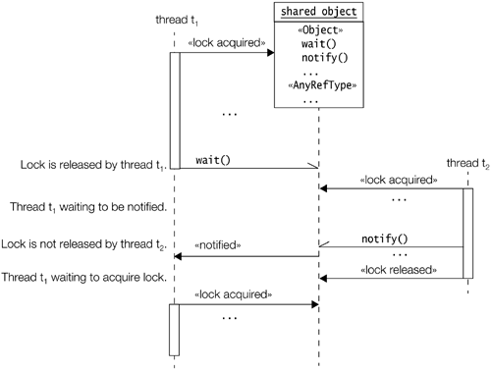
Interrupt:This means that another thread invoked the interrupt() method on the waiting thread.
But if and when the awakened thread finally gets a chance to run, the return from the wait() call will result in an InterruptedException.
This is the reason why the code invoking the wait() method must be prepared to handle this checked exception.

Slide 19
Joining:A thread can invoke the overloaded method join() on another thread in order to wait for the other thread to complete its execution before continuing, that is, the first thread waits for the second thread to join it after completion.
A running thread t₁ invokes the method join() on a thread t₂.
The join() call has no effect if thread t₂ has already completed.
If thread t₂ is still alive, then thread t₁ transits to the Blocked-for-join-completion state. Thread t₁ waits in this state until one of these events occur.
Thread t₂ completes.In this case thread t₁ is enabled and when it gets to run, it will continue normally after the join() method call.
Thread t₁ is timed out.The time specified in the argument in the join() method call has elapsed, without thread t₂ completing. In this case as well, thread t₁ is enabled. When it gets to run, it will continue normally after the join() method call.
Thread t₁ is interrupted.Some thread interrupted thread t₁ while thread t₁ was waiting for join completion. Thread t₁ is enabled, but when it gets to execute, it will now throw an InterruptedException.
JoinExample.java

Slide 20
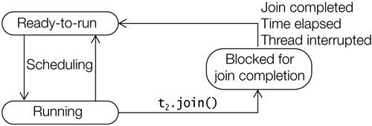
Blocking for I/O: A running thread, on executing a blocking operation requiring a resource (like a call to an I/O method), will transit to the Blocked-for-I/O state.
The blocking operation must complete before the thread can proceed to the Ready-to-run state. An example is a thread reading from the standard input terminal, which blocks until input is provided:
int input = System.in.read();
Thread Termination: A thread can transit to the Dead state from the Running or the Ready-to-run states. The thread dies when it completes its run() method, either by returning normally or by throwing an exception.
Once in this state, the thread cannot be resurrected. There is no way the thread can be enabled for running again, not even by calling the start() method once more on the thread object.

Slide 21
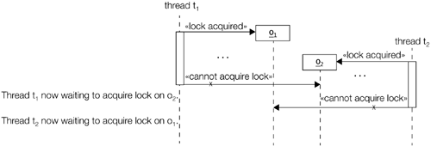
Deadlocks: A deadlock is a situation where a thread is waiting for an object lock that another thread holds, and this second thread is waiting for an object lock that the first thread holds.
Since each thread is waiting for the other thread to relinquish a lock, they both remain waiting forever in the Blocked-for-lock-acquisition state.
The threads are said to be deadlocked. DeadLockExample.java

